Slide 1
Chapter 2
Basic Operations

Slide 2
Overview
SQI_{SIGN} involves the connection between two mathematical concepts that seem unrelated:
1) Isogenies between supersingular elliptic curves over finite fields
2) Maximal orders and ideals of quaternion algebras

Slide 3
Section 2.1 - Finite Fields
A field is a relatively well-equipped algebraic structure. As a review, we can build up to it from more fundamental structures

Slide 4
Abelian group
Set Magma Semigroup Monoid
Abelian group Group

Slide 5
Field
(S, +)
a(b + c) = ab + ac (F, +, x)
(S \ {0}, x)

Slide 6
Example
An example is ℚ, the rational numbers (set of fractions with integer numerator and denominator (den ≠ 0))
Closure: Sum or multiplication of rational numbers is rational
Associativity: A sequence of addition operations can be done in any order (similarly for multiplication)
Identity: Additive identity: 0; Multiplicative identity: 1
Inverse: Can simply negate a number to get its additive inverse; Can flip a fraction to get its multiplicative inverse (remember 0 is not included here)
Commutativity: Can add or multiply two rationals in any order

Slide 7
Finite fields
We care about fields with a finite number of elements. All such fields are of prime power order (powers of a single prime). Specifically we care about F_{p} (operations are mod p) and F_{p^2} which both have characteristic p.
Ex. F_{p} = (ℤ_{p}, +, x) has characteristic p because 1 + 1 + 1 + … + 1 = 0 (mod p)
p times
We will consider p = 3 (mod 4)

Slide 8
Quadratic residue in F_{p}
Useful for later definitions throughout the paper
A number congruent to a perfect square: b² = a (mod p)
Can test if ‘a’ is a perfect square in F_{p} by raising both sides by (p - 1) / 2
b^{p-1} = a^{(p-1)/2} (mod p) = 1 (mod p) (by Fermat’s little theorem)
If this equation is not true, then ‘a’ wasn’t a perfect square to begin with

Slide 9
F_{q} for q = p²
If F_{p} was analogous to the real numbers, then F_{p^2} is analogous to the complex numbers. With i² + 1 = 0, elements of F_{p^2} are of the form a₀ + a₁i for a₀, a₁ in F_{p}
It’s additive and multiplicative operations are the familiar ones when working with complex numbers. For instance, the multiplicative inverse of a + bi is:
1 1 (a-bi) a-bi
a + bi a+ bi (a-bi) a² + b²

Slide 10
Section 2.2 - Elliptic Curves
Montgomery elliptic curves are curves of the form: By² = x³ + Ax² + x
We also importantly consider a “point at infinity”, ∞, to be part of the curve
Two curves are isomorphic if there is a bijective (one-to-one correspondence) mapping between them of the form (x, y) (D(x + R), Cy)
They are “quadratic twists” of one another if C = √(B/B’) and are isomorphic if B/B’ is a perfect square

Slide 11
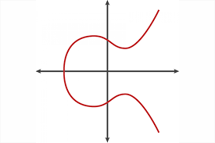
Elliptic curve over the real numbers

Slide 12
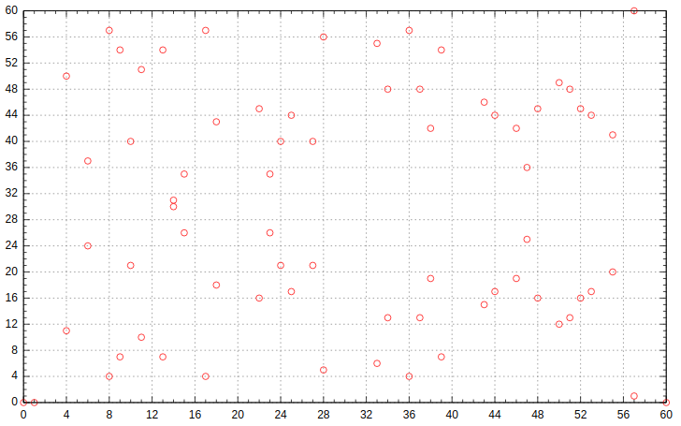
An elliptic curve over the finite field, F₆₁

Slide 13
Supersingular meaning
If the number of solutions to the curve is congruent to 1 mod char(F_{q}), it is called supersingular.
Recall we care about p = 3 (mod 4) and F_{p^2}
In this case, if B = 1, the curve has exactly (p + 1)² points
Ex. B = 1, p = 7, (7 + 1)² = 64 mod 7 = 1 (mod 7) ✓

Slide 14
Group structure of elliptic curves
Collectively supplementing the points on the elliptic curve with a binary addition operation yields an abelian group!

